Slide 1
«Alfa-Avto: Mobile advisor»

Slide 2
«Alfa-Avto: Mobile advisor»
Prerequisites
Requests from distributers of automobile brands
Desire to improve work efficiency
Difficulties in accessories’ sales in a segment of “After sales”
Desire to improve quality service and customer loyalty

Slide 3
Цели
«Alfa-Avto: Mobile advisor»
Intended purpose of product
Single point of data input when accepting an vehicle
Access point to current information by key parameters (customer, vehicle)
Assistance with accessories’ sales by providing the most complete information about offered products and services
Well-timed response of service advisor to delays

Slide 4
Набор функций первой редакции приложения
«Alfa-Avto: Mobile advisor»
Feature set in first edition
Journal of repair requests
Journal of planned contacts with customers
Access to history of automobiles service
Access to information about current (revocable) service campaigns
Full cycle of walk-around check for filling acceptance certificate
Catalog of accessories and additional proposals working on principle of web shop’s “cart”

Slide 5
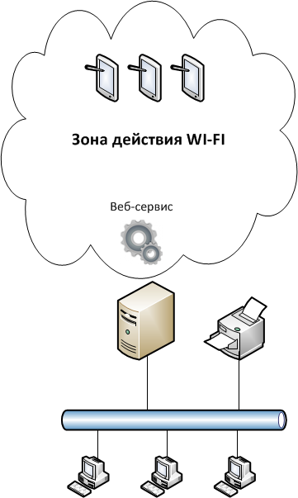
Стоимость и лицензирование
«Alfa-Avto: Mobile advisor»
System architecture and constraints
For interaction between mobile devices and infobase of “Alfa-Avto” wireless network is required
HTTP data exchange via web service
Offline mode available (without synchronization with server)
Mobile devices at 7 inches and larger, measured diagonally
Android operating system
“ARM” processor architecture (Intel architecture is temporarily not supported)
WIFI coverage
Web service

Slide 6
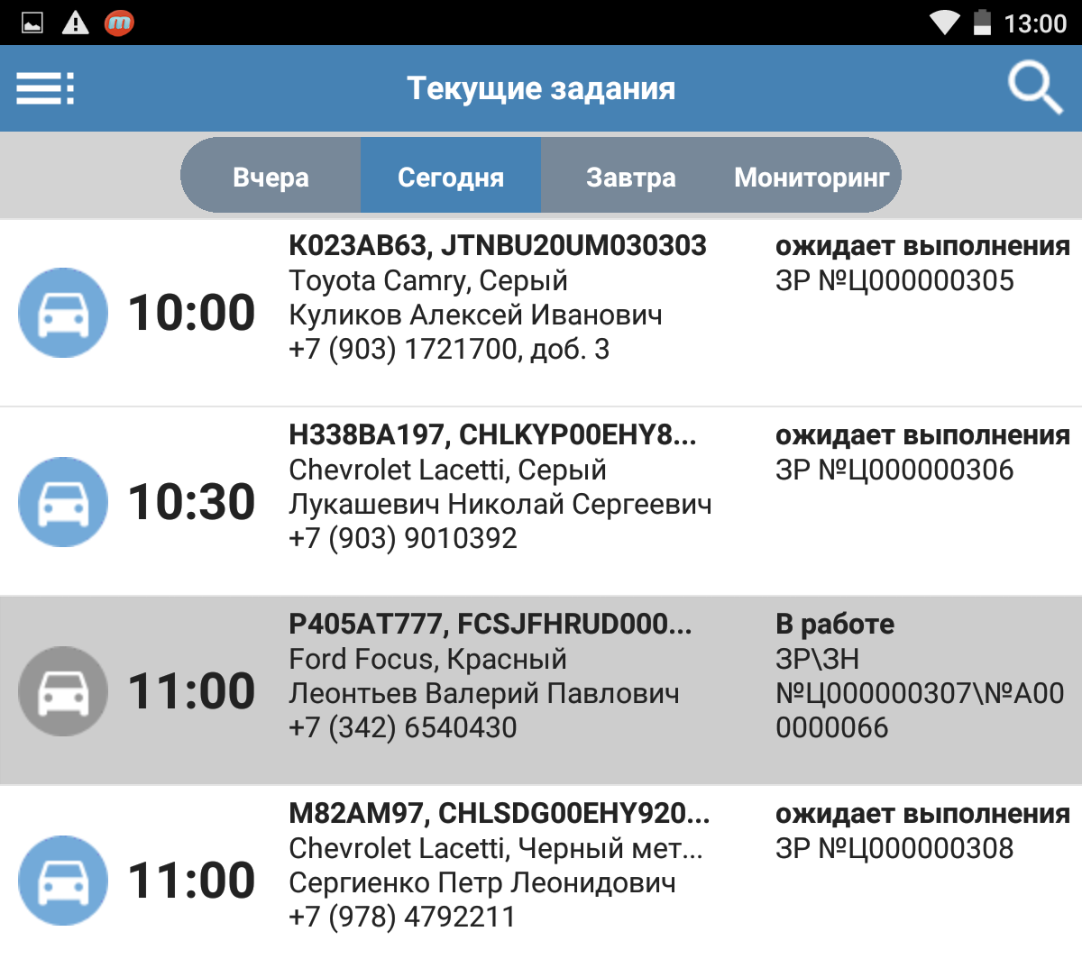
Журнал записи на ремонт
«Alfa-Avto: Mobile advisor»
Journal of repair requests
List of nearest requests:
yesterday, today, tomorrow
Request search by key parameters
Colored highlighter:
New repair requests
Current status of repair
Gray highlighter:
Requests in progress
Document numbers in
infobase

Slide 7
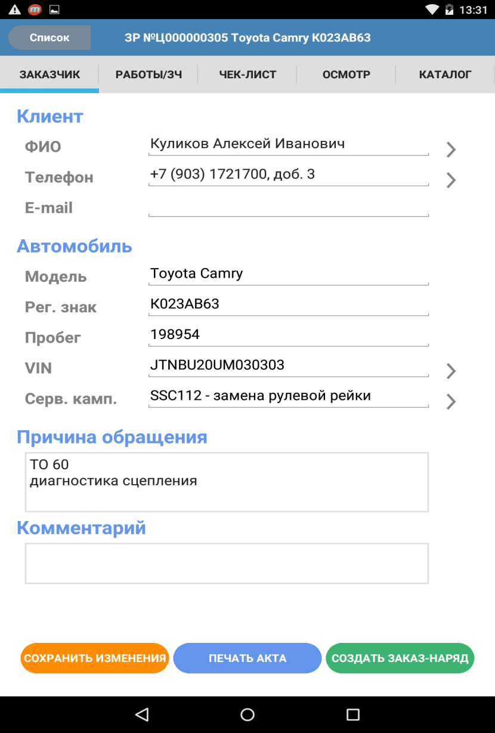
Редактирование данных клиента и а/м
«Alfa-Avto: Mobile advisor»
Editing customer’s and automobile’s data
License plate, mileage,
VIN can be edited without opening additional forms
Field extension buttons allow to go to form where
customer’s full name and
contact details can be edited
Reason for visit –
customer’s demands
written in his words. Can be edited based on
results
“VIN” field extension button
allows to go to form where
history of automobile’s
service can be viewed
“Save changes” button
starts session of
synchronization with
server. Edited data is
preserved in documents
in infobase (available
only in Online-mode)
“Service campaign” field
extension button allows to
check whether service
campaigns are need to be
run.
*VIN field must be filled

Slide 8
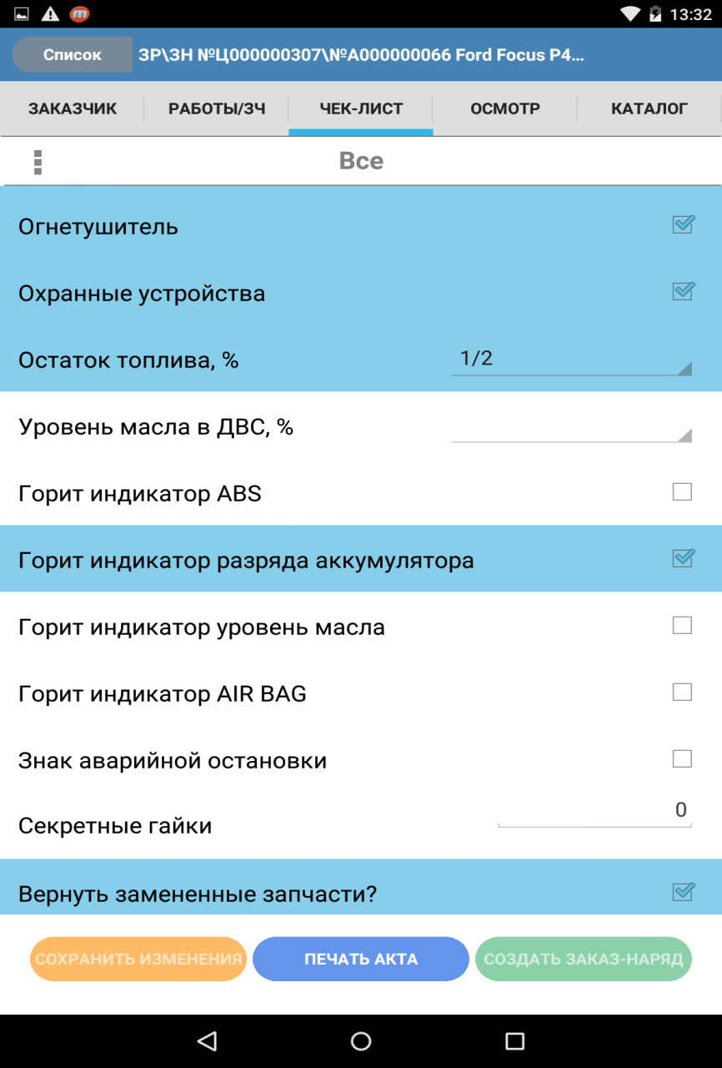
Чек-лист
«Alfa-Avto: Mobile advisor»
Checklist
List of questions can have hierarchy structure.
Toolbar button allows to
switch between groups of
questions
Check boxes are used for answers to yes/no
questions
Answered questions are
highlighted
Other types of answers:
Selection one of the
options
Text
Number

Slide 9
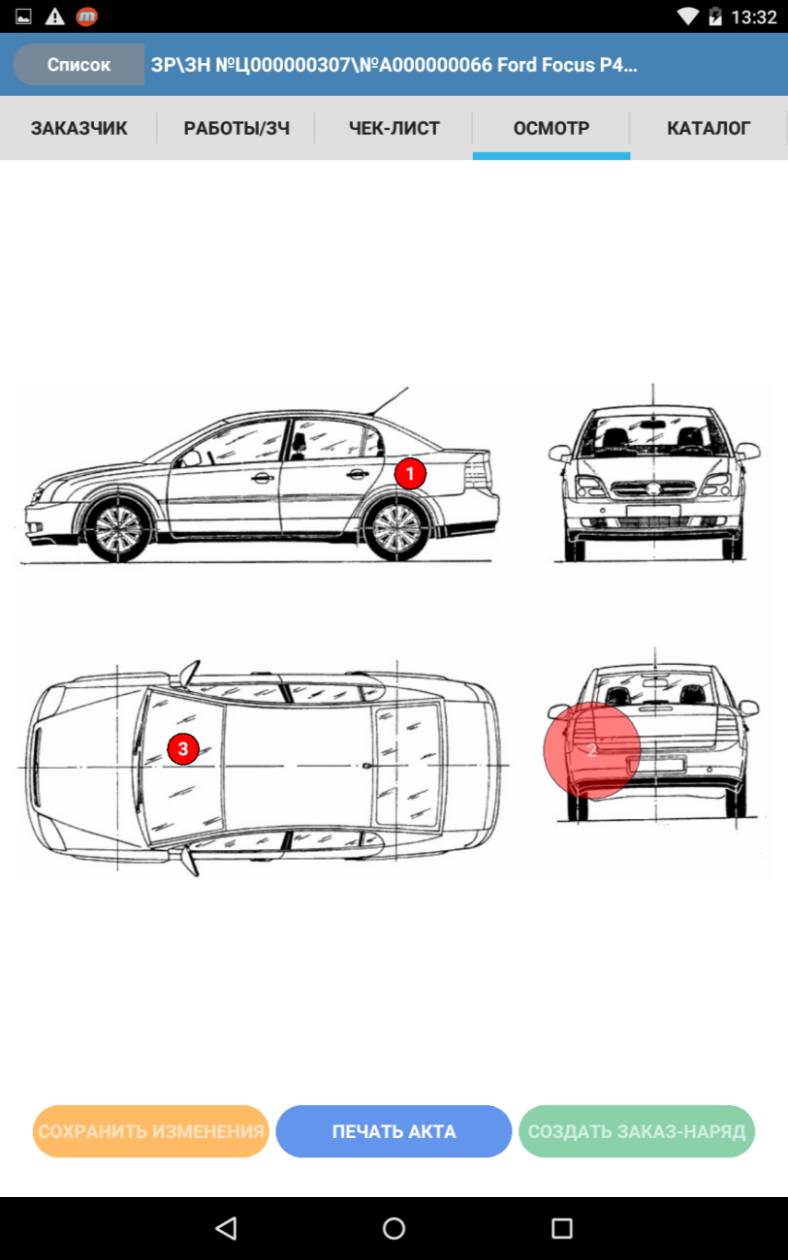
Осмотр
«Alfa-Avto: Mobile advisor»
Examination
Default graphical
scheme can be used as well as appointed to each model (in list
“Models”) graphical
schemes
Damages are marked with
bright marker with numerical order
When you click on "Print
act" button, mobile
application sends a
command to create
printing form of the act.
Printing is performed on
the printer specified in
settings
Editing mode is activated
after repeated click. In this mode marker can be moved, pictures and text notes can
be added

Slide 10
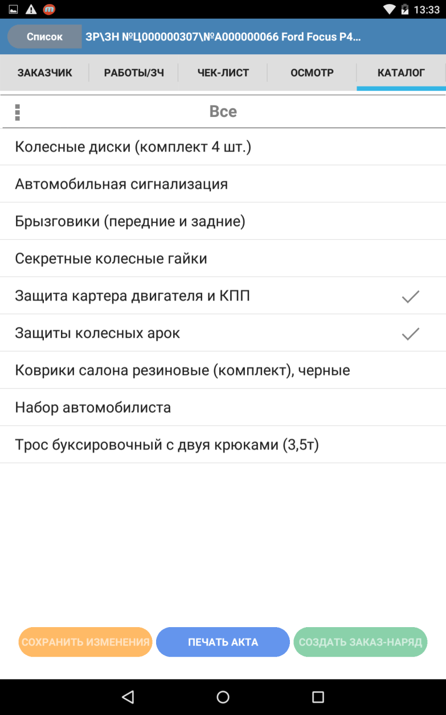
Каталог аксессуаров и пакетных предложений
«Alfa-Avto: Mobile advisor»
Catalogue of package offers
List of offers in catalogue
can have hierarchy
structure. Toolbar button
allows to switch between
groups of catalogues
Selected offers are marked with checkmark
Pressing on lines allows to
view detailed information
about the offer

Slide 11
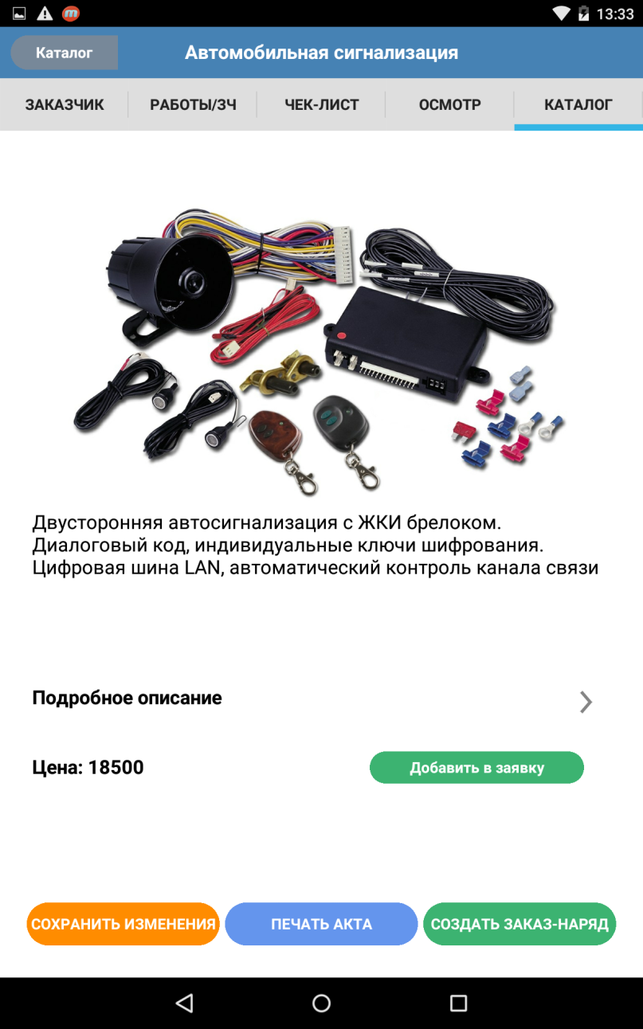
Детальная информация
«Alfa-Avto: Mobile advisor»
Detailed information about offers
Image of the accessory or
package offer. Configured
in infobase, loaded with
data synchronization
Detailed description
(PDF file)
Short text description
Price (without discounts)
Button for quick addition to
request

Slide 12
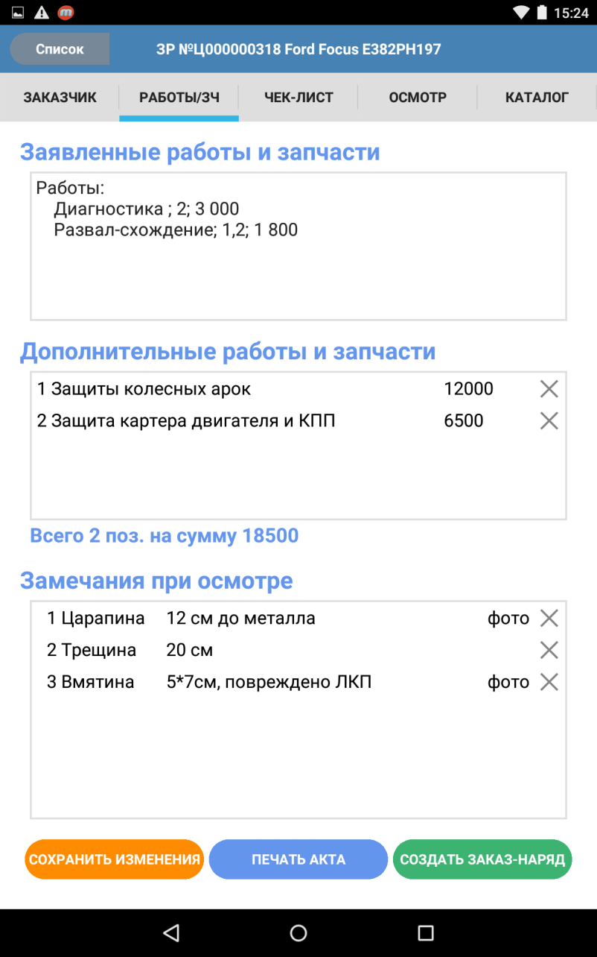
Завершение приемки
«Alfa-Avto: Mobile advisor»
Completion of acceptance
Registered works (before
request was downloaded
into application)
Accessories and package
offers ,selected in
“Catalogue” tab
Prices and remove buttons
are displayed
Text descriptions, attached
pictures, remove buttons are displayed
Damages, marked in
“Examination” tab
When you click on "Create Workshop order" button
synchronization of changes
starts, and command to
create "Workshop Order“
document is sent

Slide 13
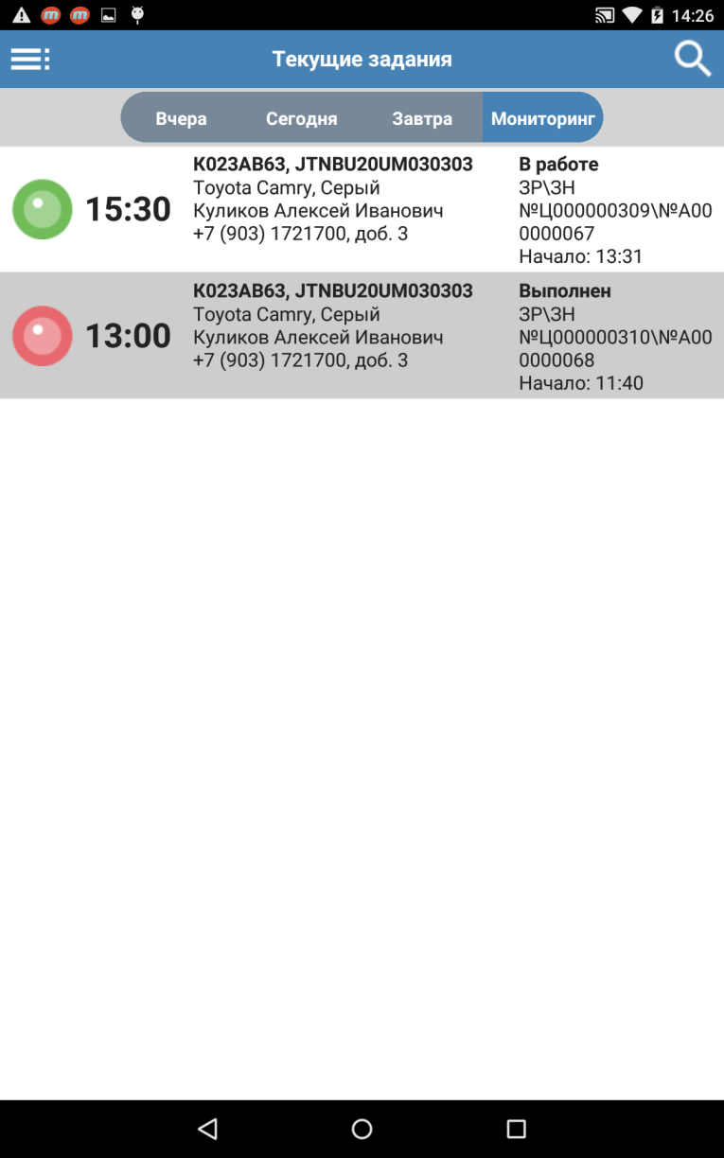
Мониторинг
«Alfa-Avto: Mobile advisor»
Monitoring
Request is denoted by
green marker if scheduled
time of automobile
releasing to customer
hasn’t yet fall due
“Monitoring” tab is
available in main window
“Current tasks ”
Following information is
provided in lines:
Customer’s and
automobile’s data
Current status of repair
Document numbers in
infobase
Starting time
Request is denoted by red marker if scheduled time of automobile releasing to
customer is overdue

Slide 14
Планы развития
«Alfa-Avto: Mobile advisor»
Development plan
Staging server for integration with older releases of “Alfa-Avto” and other accounting systems
Version of application for IOS
Sending acceptance certificate to customer by e-mail
Creating requests for repair from mobile application
Continue work on ergonomics of application

Slide 15
Стоимость и лицензирование
«Alfa-Avto: Mobile advisor»
Pricing and licensing
Additions | Price, rub
Addition “Alfa-Avto”: Mobile advisor | 70 000
Readme!
«Addition «Alfa-Avto»: Mobile advisor» is designed for use with «Alfa-Avto, edition 5.1» solution
Number of «Addition «Alfa-Avto»: Mobile advisor» users is determined by the number of purchased licenses for «Alfa-Avto, edition 5.1». There are no restrictions on the amount of connected devices
The mobile application is distributed through Play Market for free.

Slide 16
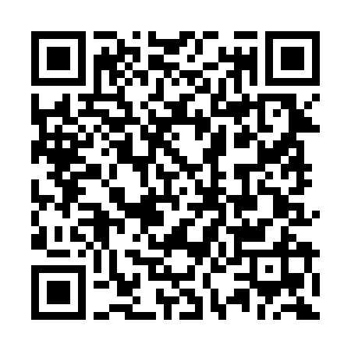
Стоимость и лицензирование
«Alfa-Avto: Mobile advisor»
Link to application
Application is already available in Play Market

Slide 17
Стоимость и лицензирование
«Alfa-Avto: Mobile advisor»
Contact us
Address: Dmitrovskoe sh. 9B, Moscow
Phone/fax: +7 (495) 223-04-04, +7 (495) 231-20-02
E-mail: alfa@rarus.ru
Web: www.rarus.ru

Slide 18
Стоимость и лицензирование
«Alfa-Auto: Mobile advisor»
Thank you for your attention!

